Slide 1
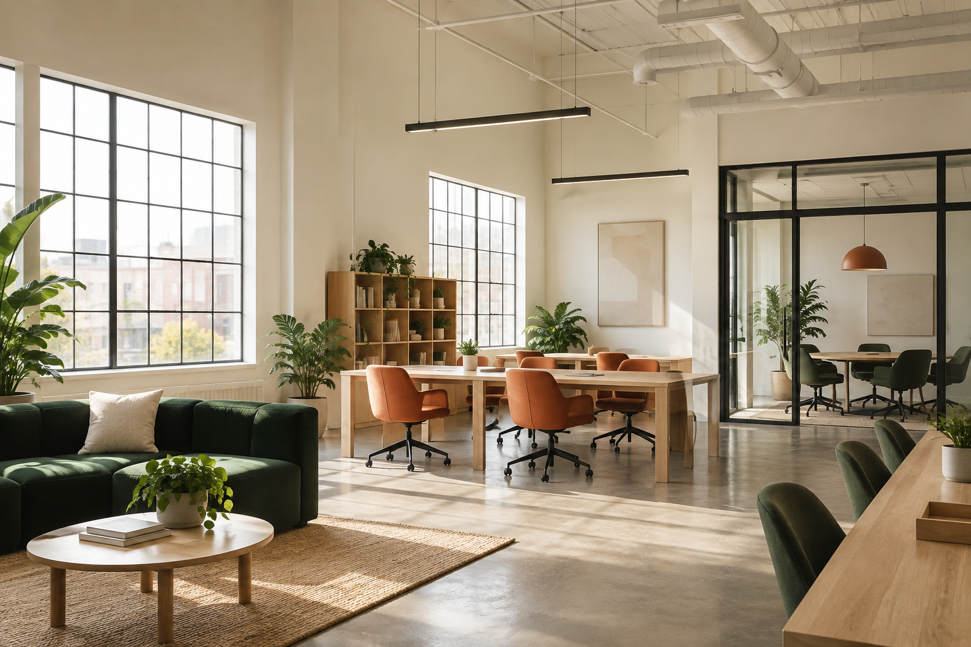
ACME WORKSPACES
Welcome to Acme Workspaces
Harbor, Midtown and Garden
Desks for your working day and rooms for your next meeting
1 / 12 • Fictional Acme Inc.
Notes:
Introduce Acme Inc., trading as Acme Workspaces, as a fictional coworking company in Port Alder. This welcome deck gives an overview, while the documentation has complete procedures. The member app is a read-only demonstration with sample account data. It cannot create a booking or establish a payment. Keep those distinctions when using the slides to answer a practical question.

Slide 2
ACME WORKSPACES
Three locations
Harbor: Pebble and Maple
Midtown: Cedar and Summit
Garden: Willow and Fern
2 / 12 • Fictional Acme Inc.
Notes:
Each location belongs to the same company. A Flex home location is a membership attribute. Check the actual site and room together because capacity, price and credit eligibility depend on them. Harbor and Garden have step-free main entrances; Midtown uses the east entrance. The written summary does not describe every interior route.

Slide 3
ACME WORKSPACES
Monthly memberships
Plan | Monthly price | Desk allowance
Flex | $129 | 8 days at home location
Unlimited | $249 | All locations in member hours
Team | $599 | 20 shared days / up to 5 people
3 / 12 • Fictional Acme Inc.
Notes:
All prices are USD including the fictional taxes in the Acme catalogue. Flex has eight home-location desk days. Unlimited uses all locations during member hours. Team pools twenty visits across up to five named people. A partial-day visit uses a visit day. Do not treat all three plans as the same access entitlement with different prices.

Slide 4
ACME WORKSPACES
Desk days and room time
Desk visits count people and dates
Room credits count eligible minutes
Room bookings need confirmation
4 / 12 • Fictional Acme Inc.
Notes:
The shared Team example is four people attending on three dates: twelve visits used, eight left. A room booking exists only after confirmation with a booking ID. A calculator, a selected slot and a demonstration row do not establish live availability or a reservation. Count attendees separately from named desk members.

Slide 5
ACME WORKSPACES
Unlimited room allowance
Unlimited includes two room credits per billing period
One credit covers 30 minutes in Harbor Pebble or Maple
5 / 12 • Fictional Acme Inc.
Notes:
The room credits shown here reset at the billing anniversary without rollover. They cover time only in the eligible Harbor rooms and do not pay for other locations or catering. Remaining duration is charged at the room rate. Keep the plan and period with the allowance when explaining the number on this slide.

Slide 6
ACME WORKSPACES
Room sizes and rates
Four people: $20/hour
Eight people: $35/hour
Sixteen people in Summit: $60/hour
6 / 12 • Fictional Acme Inc.
Notes:
Pebble, Cedar and Willow hold four. Maple and Fern hold eight. Summit belongs to Midtown and holds sixteen. Every room has a one-hour minimum, followed by thirty-minute increments. Two hours in Maple costs $70 before credits. Summit for 1.5 hours costs $90 and cannot use room credits.

Slide 7
ACME WORKSPACES
Annual Unlimited
Pay $2,628 upfront
Equivalent to $219 per month
Four credits reset at each monthly anniversary
7 / 12 • Fictional Acme Inc.
Notes:
Annual payment exists only for Unlimited. The equivalent monthly figure describes a twelve-month comparison and is not a recurring $219 monthly charge. Annual credits do not all arrive at once. Flex and Team have no annual option in the catalogue. Read the annual renewal notice before relying on a monthly deadline.

Slide 8
ACME WORKSPACES
Guests and room attendees
Two accompanied common-area guests
Up to two hours during staffed hours
Room attendees follow room capacity
8 / 12 • Fictional Acme Inc.
Notes:
Paid members may host the common-area guests described on the slide. A day-pass holder has no guest allowance. A booked Summit session can have sixteen attendees within room capacity; that does not permit sixteen common-area guests under one member. A room booking also does not supply desk entitlements to all attendees.

Slide 9
ACME WORKSPACES
Harbor access hours
Unlimited access at Harbor is 06:00–22:00 daily
Reception is staffed weekdays 09:00–18:00
9 / 12 • Fictional Acme Inc.
Notes:
These are two different windows: member access and reception staffing. Flex, Team and day-pass desk visits still use weekday 09:00–18:00. The longer Unlimited window does not apply to all plans. A staff-assisted arrival needs its own arrangement rather than an assumption based on a building-access time.

Slide 10
ACME WORKSPACES
Before confirming a room
Choose location, room, date and time
Check capacity and duration
Select eligible credits or payment
Review the policy and confirm
10 / 12 • Fictional Acme Inc.
Notes:
The confirmation should include a booking ID. Retain it and distinguish a cancelled booking from a replacement. Cold outside food is allowed in rooms, alcohol is not, and catering needs two business days notice. Food is a separate charge and never paid with room credits.

Slide 11
ACME WORKSPACES
Membership changes
Stopping renewal and requesting a refund are separate tasks
Use the full guide for notice and eligibility
11 / 12 • Fictional Acme Inc.
Notes:
Monthly cancellation requires at least seven calendar days before renewal, and annual cancellation requires thirty. Access continues through the paid term. A first membership purchase may be reviewed for a refund within fourteen calendar days only if no desk visit or room booking was used. Subsequent renewals are not covered by that first-purchase policy.

Slide 12
ACME WORKSPACES
Your next working day
Read the location and plan guides
Keep your current confirmation
Ask staff about missing details
12 / 12 • Fictional Acme Inc.
Notes:
Phone booths are first come, first served, with a forty-five-minute limit. The booth is not a bookable meeting room. Use the correct billing role for company invoices and the current invoice navigation. Do not invent a holiday schedule or a service that the published information does not confirm. A conversation that ends with thanks may still contain an unresolved earlier question.

